Slide 1
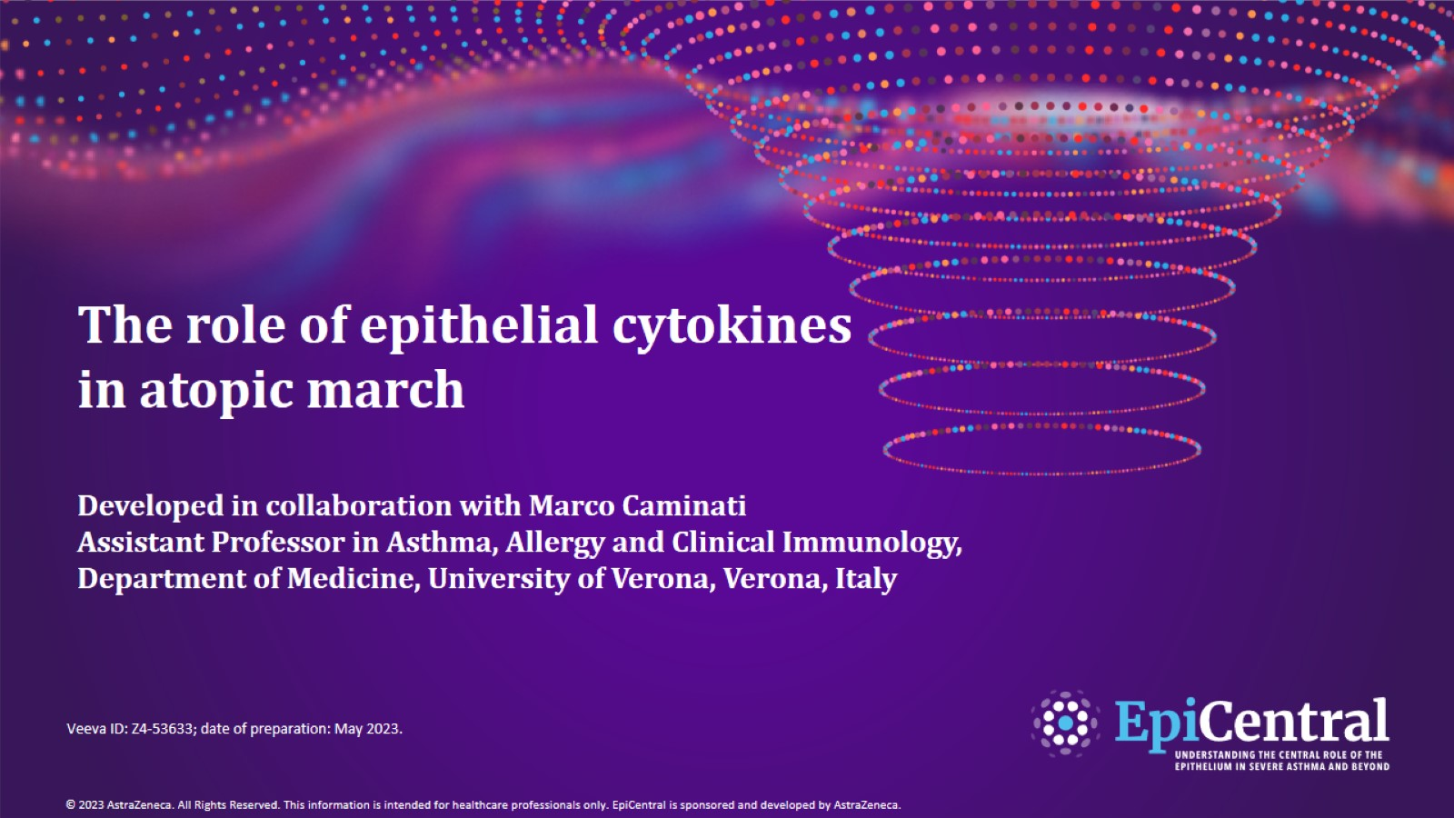
The role of epithelial cytokines in atopic march
Developed in collaboration with Marco Caminati
Assistant Professor in Asthma, Allergy and Clinical Immunology, Department of Medicine, University of Verona, Verona, Italy
CN-138976; date of preparation: Dec 2024. © 2025 AstraZeneca. All Rights Reserved. This information is intended for healthcare professionals only. EpiCentral is sponsored and developed by Amgen and AstraZeneca.

Slide 2
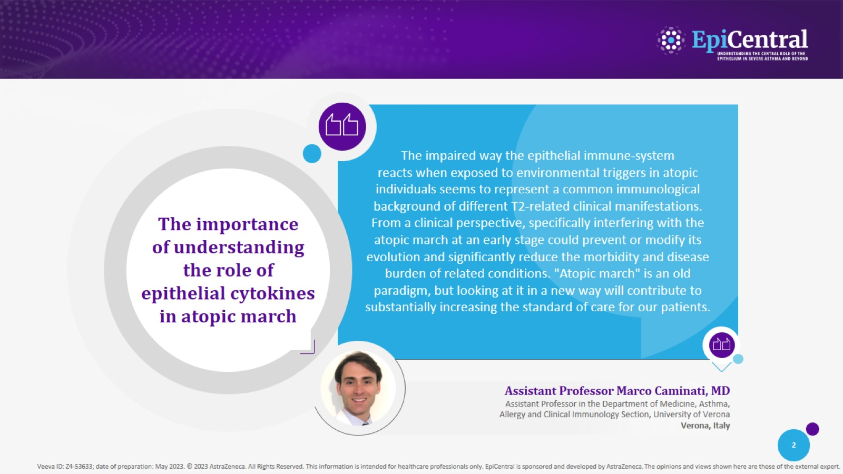
CN-138976; date of preparation: Dec 2024. © 2025 AstraZeneca. All Rights Reserved. This information is intended for healthcare professionals only. EpiCentral is sponsored and developed by Amgen and AstraZeneca.

Slide 3
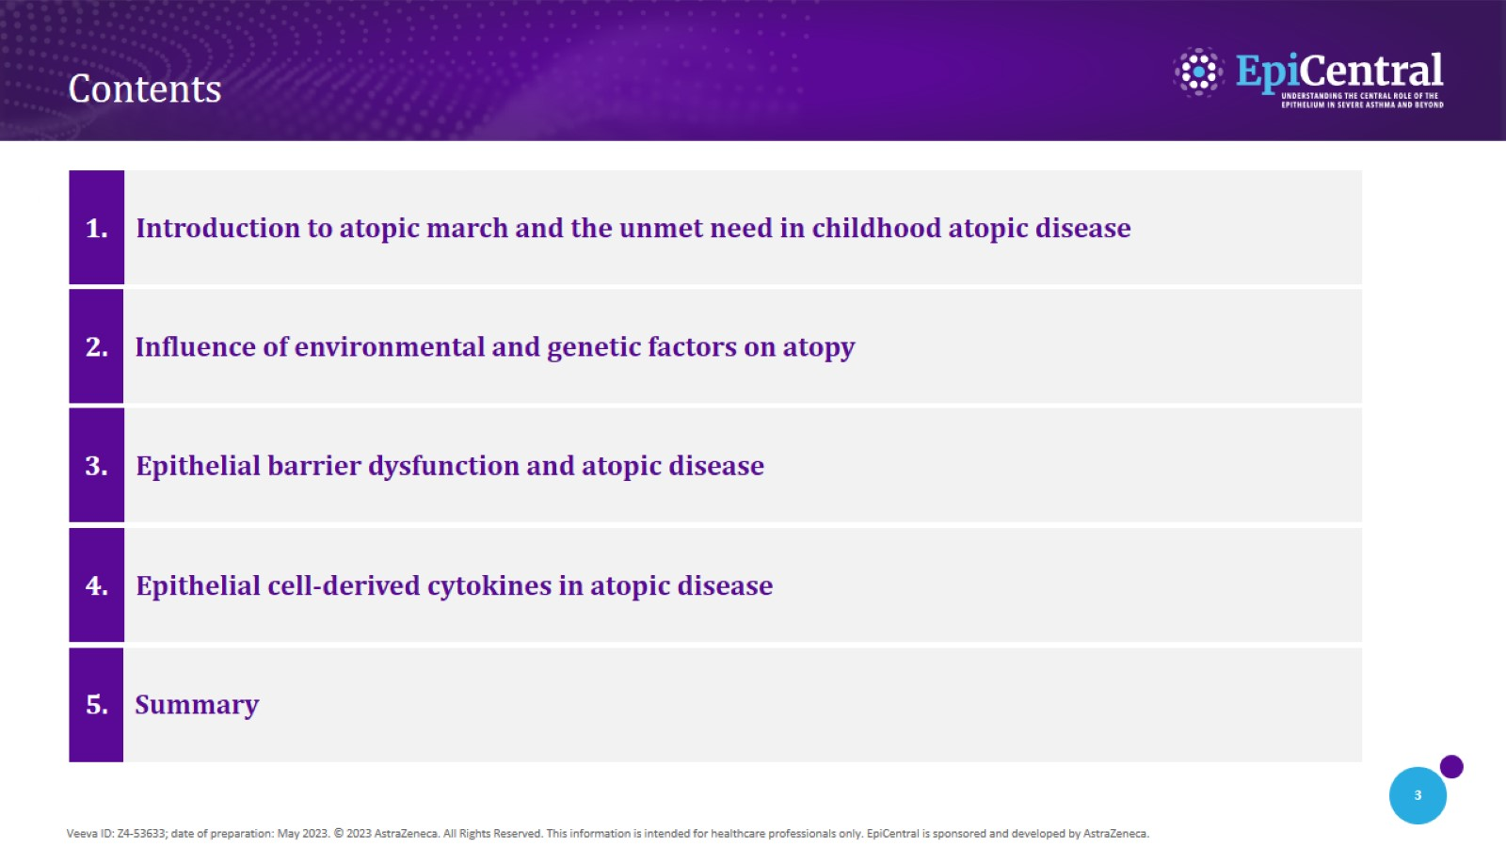
Contents
CN-138976; date of preparation: Dec 2024. © 2025 AstraZeneca. All Rights Reserved. This information is intended for healthcare professionals only. EpiCentral is sponsored and developed by Amgen and AstraZeneca.

Slide 4
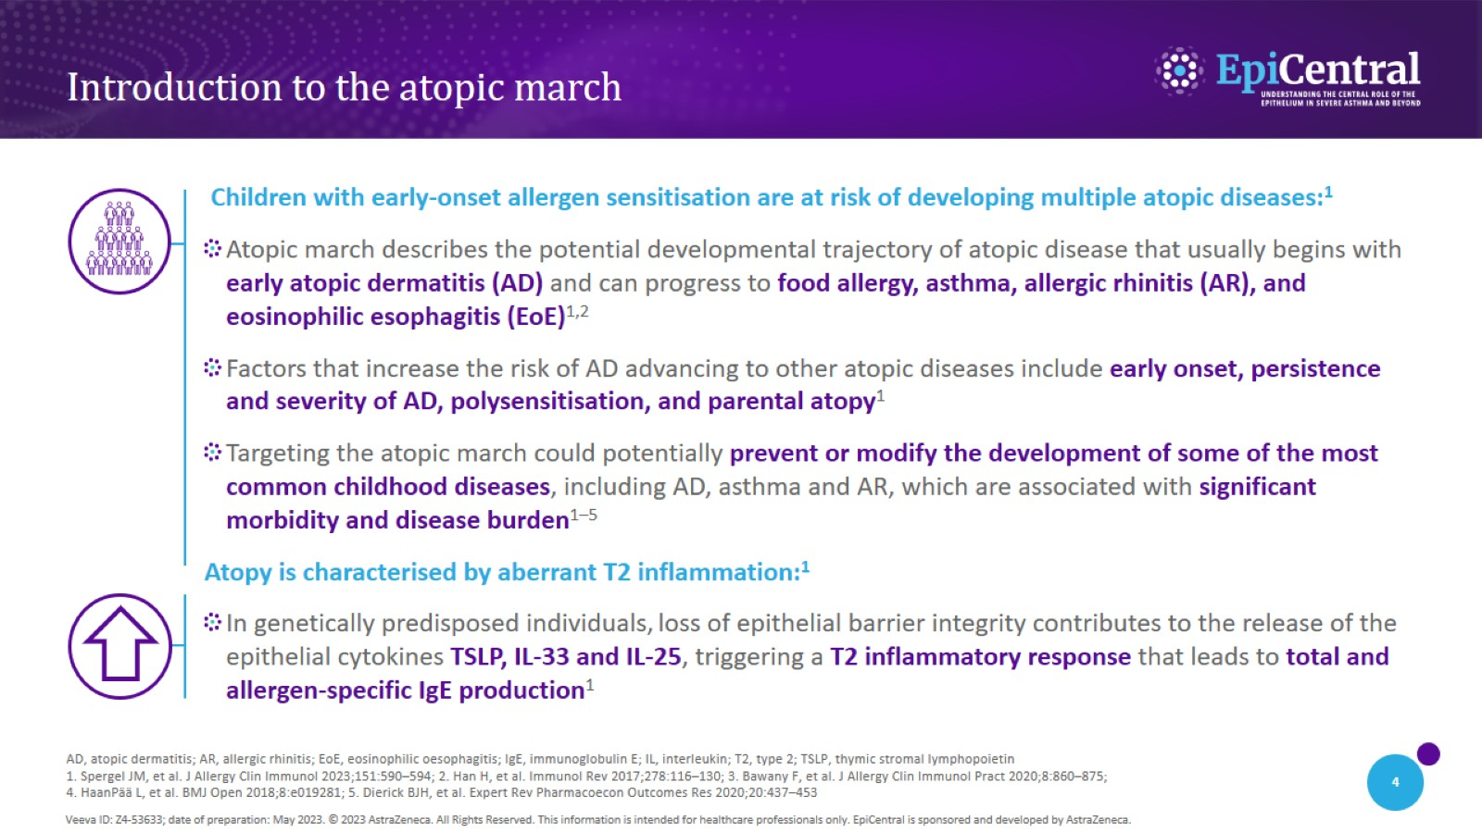
Introduction to the atopic march
CN-138976; date of preparation: Dec 2024. © 2025 AstraZeneca. All Rights Reserved. This information is intended for healthcare professionals only. EpiCentral is sponsored and developed by Amgen and AstraZeneca.

Slide 5
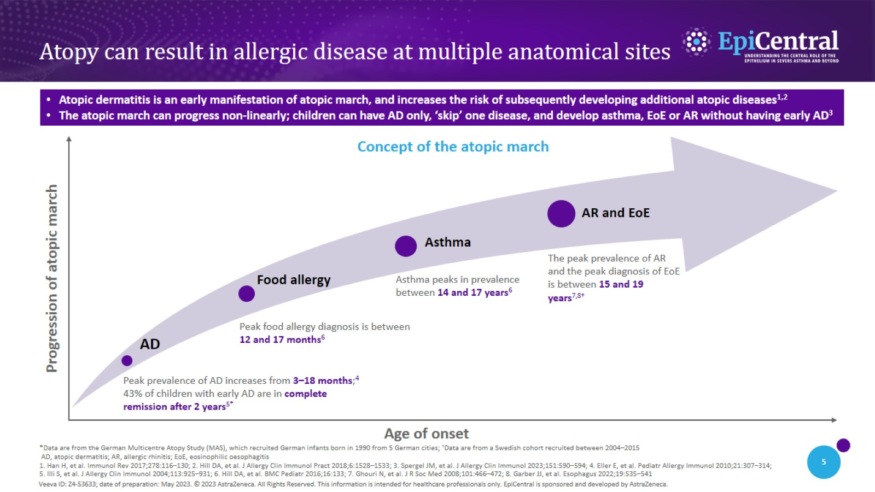
Atopy can result in allergic disease at multiple anatomical sites
CN-138976; date of preparation: Dec 2024. © 2025 AstraZeneca. All Rights Reserved. This information is intended for healthcare professionals only. EpiCentral is sponsored and developed by Amgen and AstraZeneca.

Slide 6
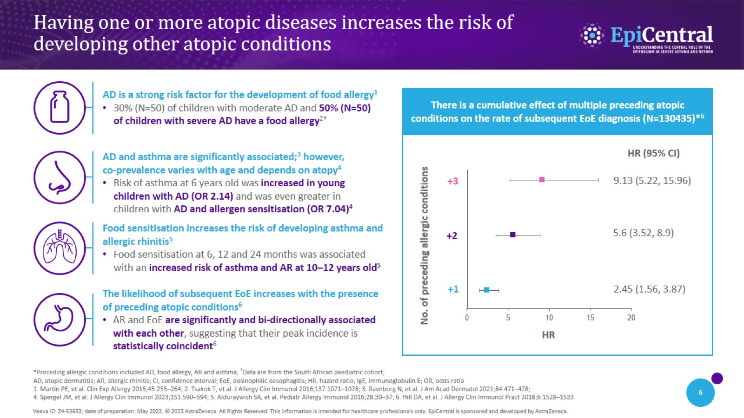
Having one or more atopic diseases increases the risk of developing other atopic conditions
CN-138976; date of preparation: Dec 2024. © 2025 AstraZeneca. All Rights Reserved. This information is intended for healthcare professionals only. EpiCentral is sponsored and developed by Amgen and AstraZeneca.

Slide 7
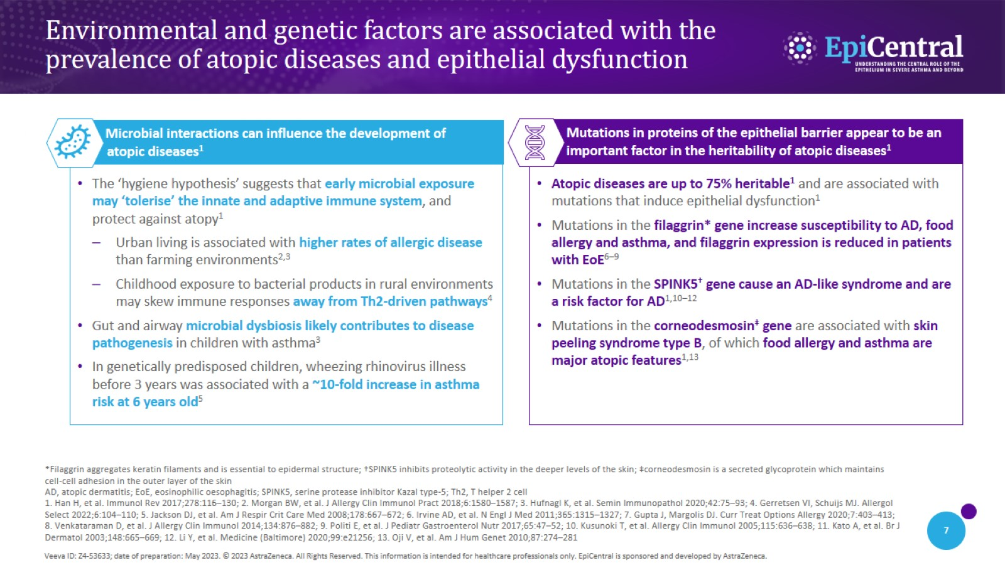
Environmental and genetic factors are associated with the prevalence of atopic diseases and epithelial dysfunction
CN-138976; date of preparation: Dec 2024. © 2025 AstraZeneca. All Rights Reserved. This information is intended for healthcare professionals only. EpiCentral is sponsored and developed by Amgen and AstraZeneca.

Slide 8
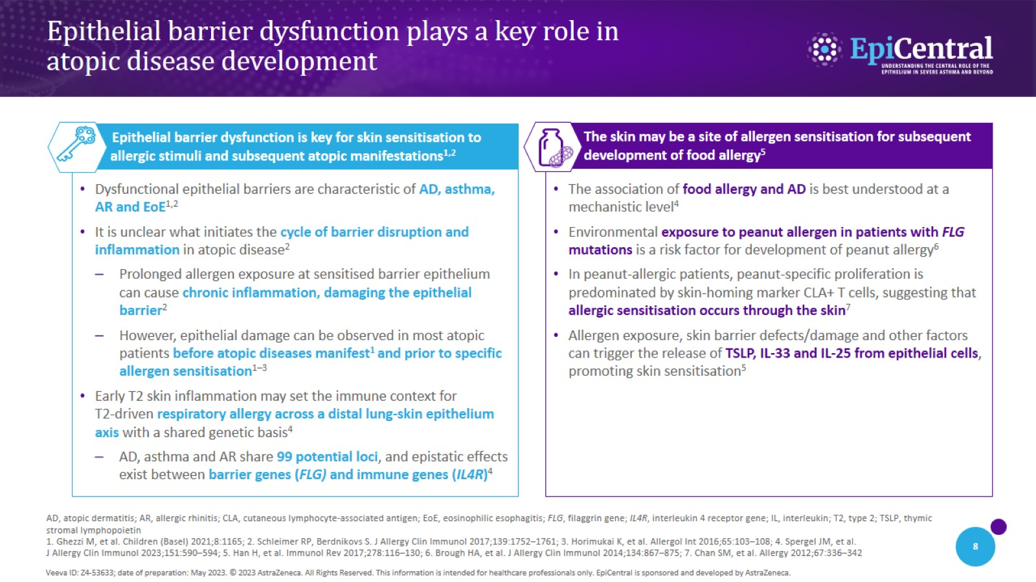
Epithelial barrier dysfunction plays a key role in atopic disease development
CN-138976; date of preparation: Dec 2024. © 2025 AstraZeneca. All Rights Reserved. This information is intended for healthcare professionals only. EpiCentral is sponsored and developed by Amgen and AstraZeneca.

Slide 9
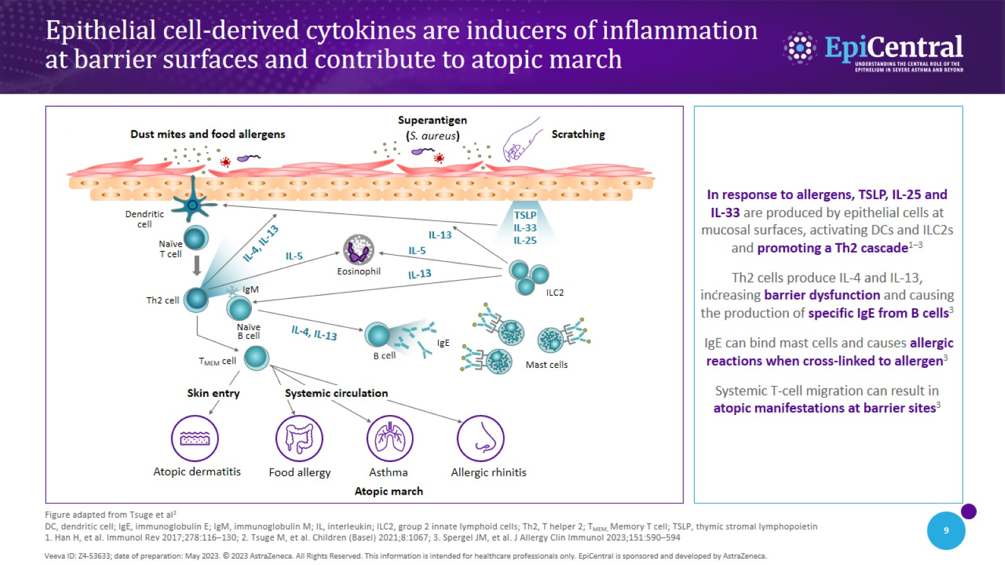
Epithelial cell-derived cytokines are inducers of inflammation at barrier surfaces and contribute to atopic march
CN-138976; date of preparation: Dec 2024. © 2025 AstraZeneca. All Rights Reserved. This information is intended for healthcare professionals only. EpiCentral is sponsored and developed by Amgen and AstraZeneca.

Slide 10
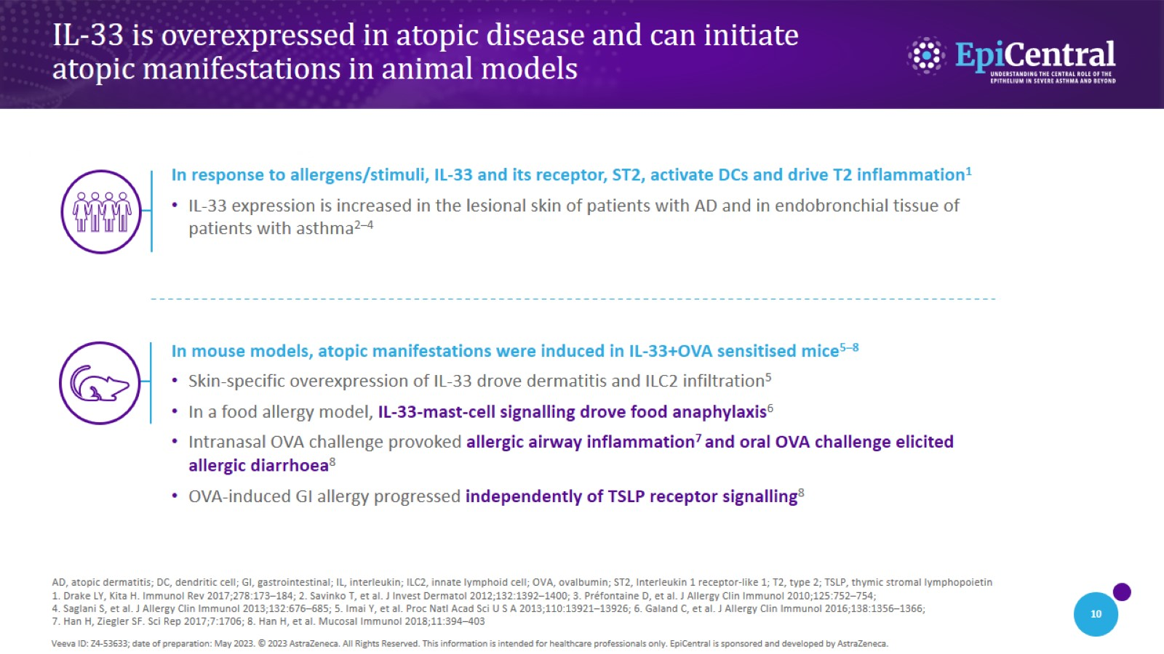
IL-33 is overexpressed in atopic disease and can initiate atopic manifestations in animal models
CN-138976; date of preparation: Dec 2024. © 2025 AstraZeneca. All Rights Reserved. This information is intended for healthcare professionals only. EpiCentral is sponsored and developed by Amgen and AstraZeneca.

Slide 11
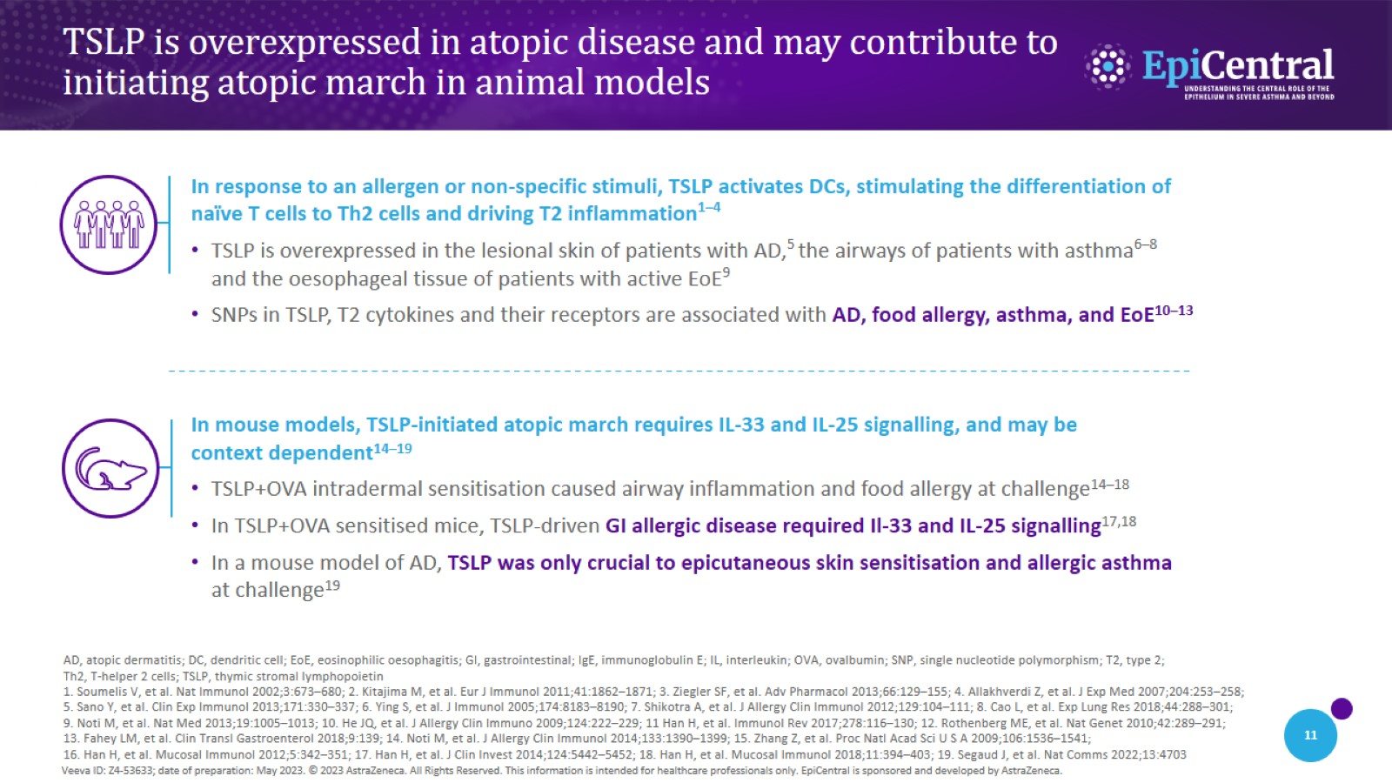
TSLP is overexpressed in atopic disease and may contribute to initiating atopic march in animal models
CN-138976; date of preparation: Dec 2024. © 2025 AstraZeneca. All Rights Reserved. This information is intended for healthcare professionals only. EpiCentral is sponsored and developed by Amgen and AstraZeneca.

Slide 12
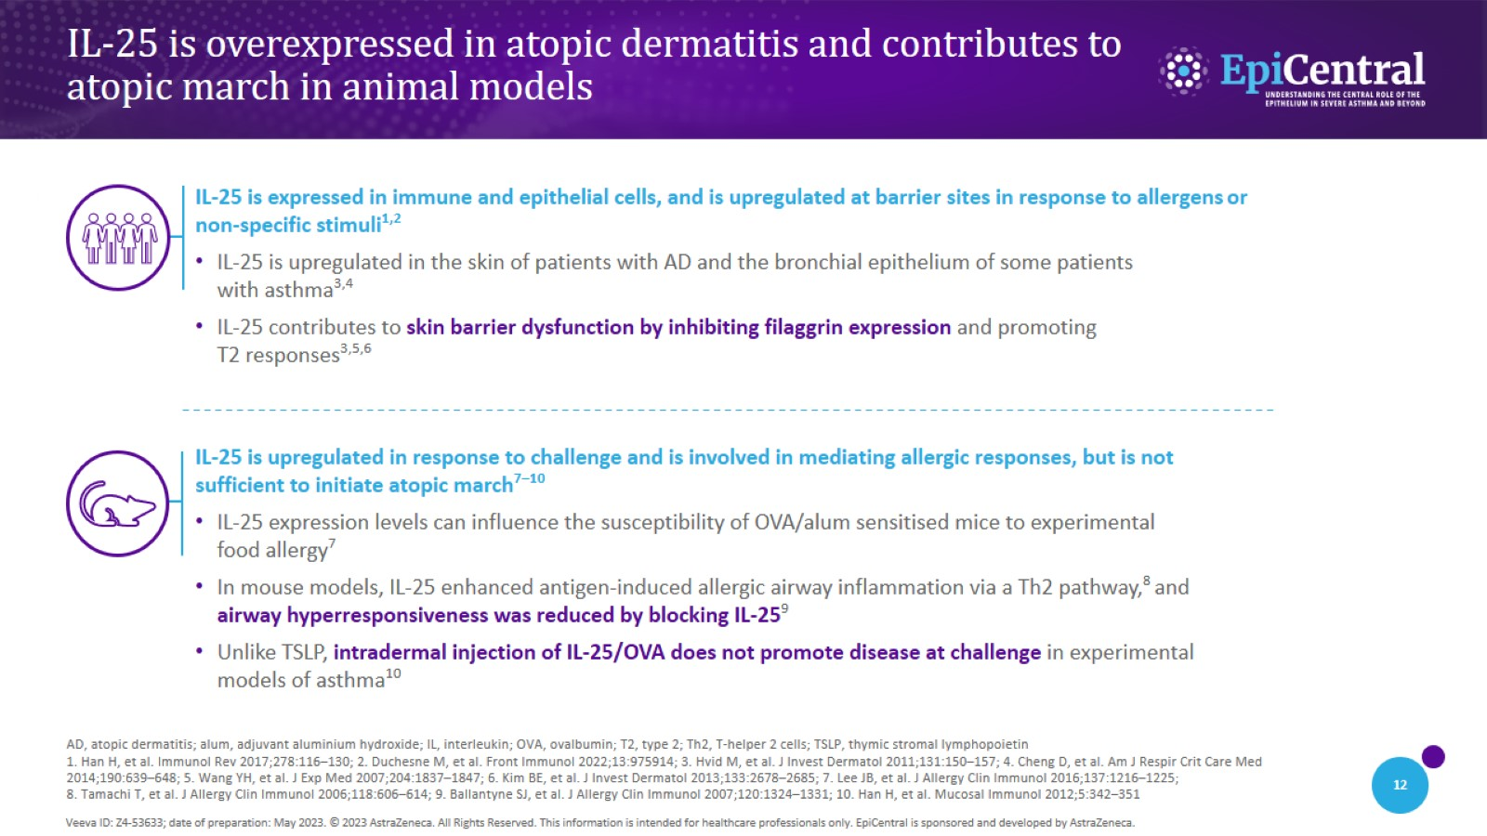
IL-25 is overexpressed in atopic dermatitis and contributes to atopic march in animal models
CN-138976; date of preparation: Dec 2024. © 2025 AstraZeneca. All Rights Reserved. This information is intended for healthcare professionals only. EpiCentral is sponsored and developed by Amgen and AstraZeneca.

Slide 13
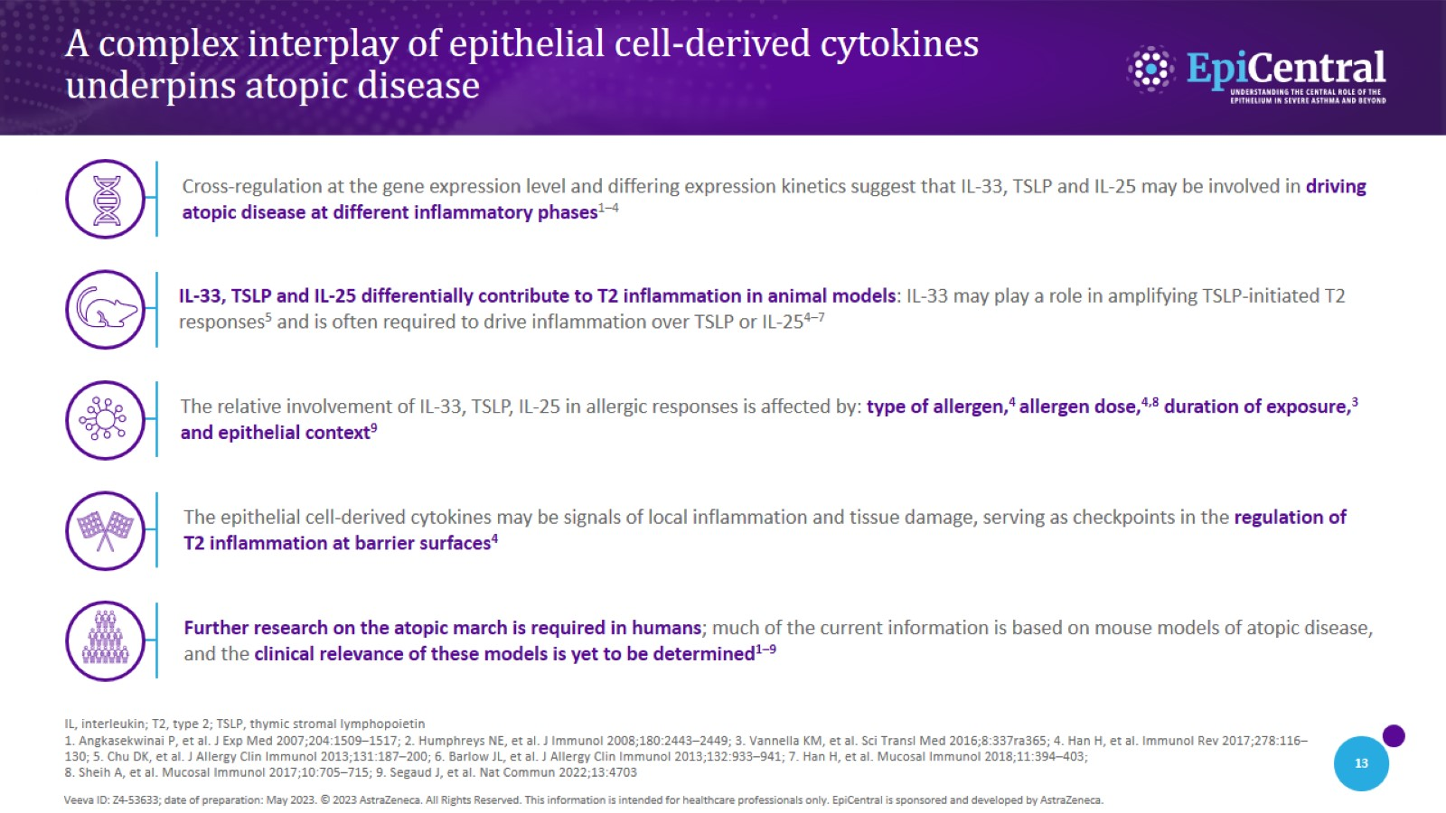
A complex interplay of epithelial cell-derived cytokines underpins atopic disease
CN-138976; date of preparation: Dec 2024. © 2025 AstraZeneca. All Rights Reserved. This information is intended for healthcare professionals only. EpiCentral is sponsored and developed by Amgen and AstraZeneca.

Slide 14
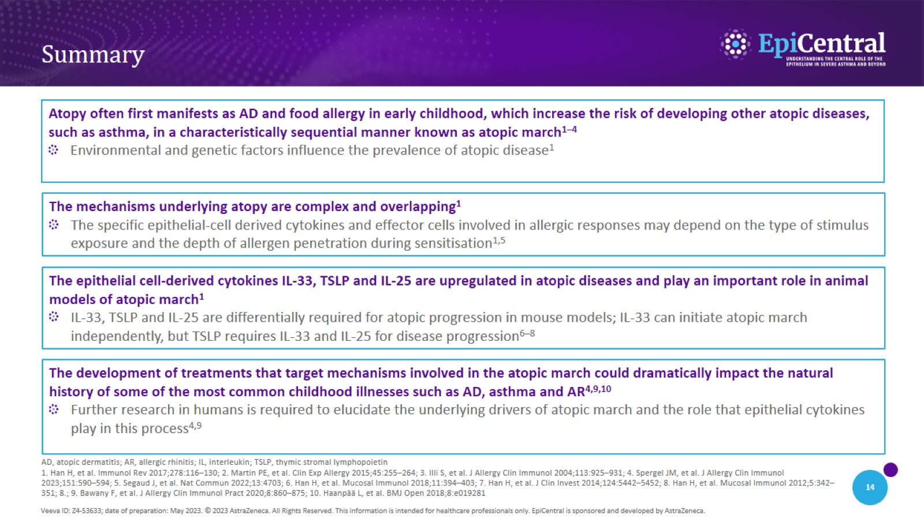
Summary
CN-138976; date of preparation: Dec 2024. © 2025 AstraZeneca. All Rights Reserved. This information is intended for healthcare professionals only. EpiCentral is sponsored and developed by Amgen and AstraZeneca.

